Slide 1
Chengdu-80
Stock Trend Prediction
CQUSunrise Group
2020/10/29

Slide 2
ARIMA
We divide the task into two parts. First, we forecast the future movement of the stock. Second, we make a reasonable explanation for the prediction results.
LSTM-Based PTS Model
Knowledge Distillation

Slide 3
Prediction: Arima Model

Slide 4
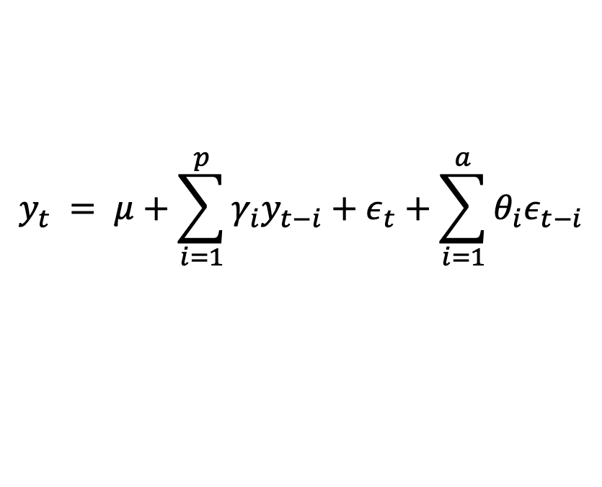
ARIMA
First we use statistical model to emulate the stock’s movement
$$y_{t} = μ+\sum_{i=1}^{p}{γ_{i}y_{t−i}+ε_{t}+\sum_{i=1}^{a}{θ_{i}ε_{t−i}}}$$
On the basis of the above formula, the difference is added to ensure the stability of the data. For the given stock dataset, first order difference is enough.
There are three parameters for this model:
p: The number of lag observations included in the model, also called the lag order.
d: The number of times that the raw observations are differenced, also called the degree of differencing.
q: The size of the moving average window, also called the order of moving average.
We set them as (5,1,2)

Slide 5
Prediction: LSTM-Based PTS Model

Slide 6
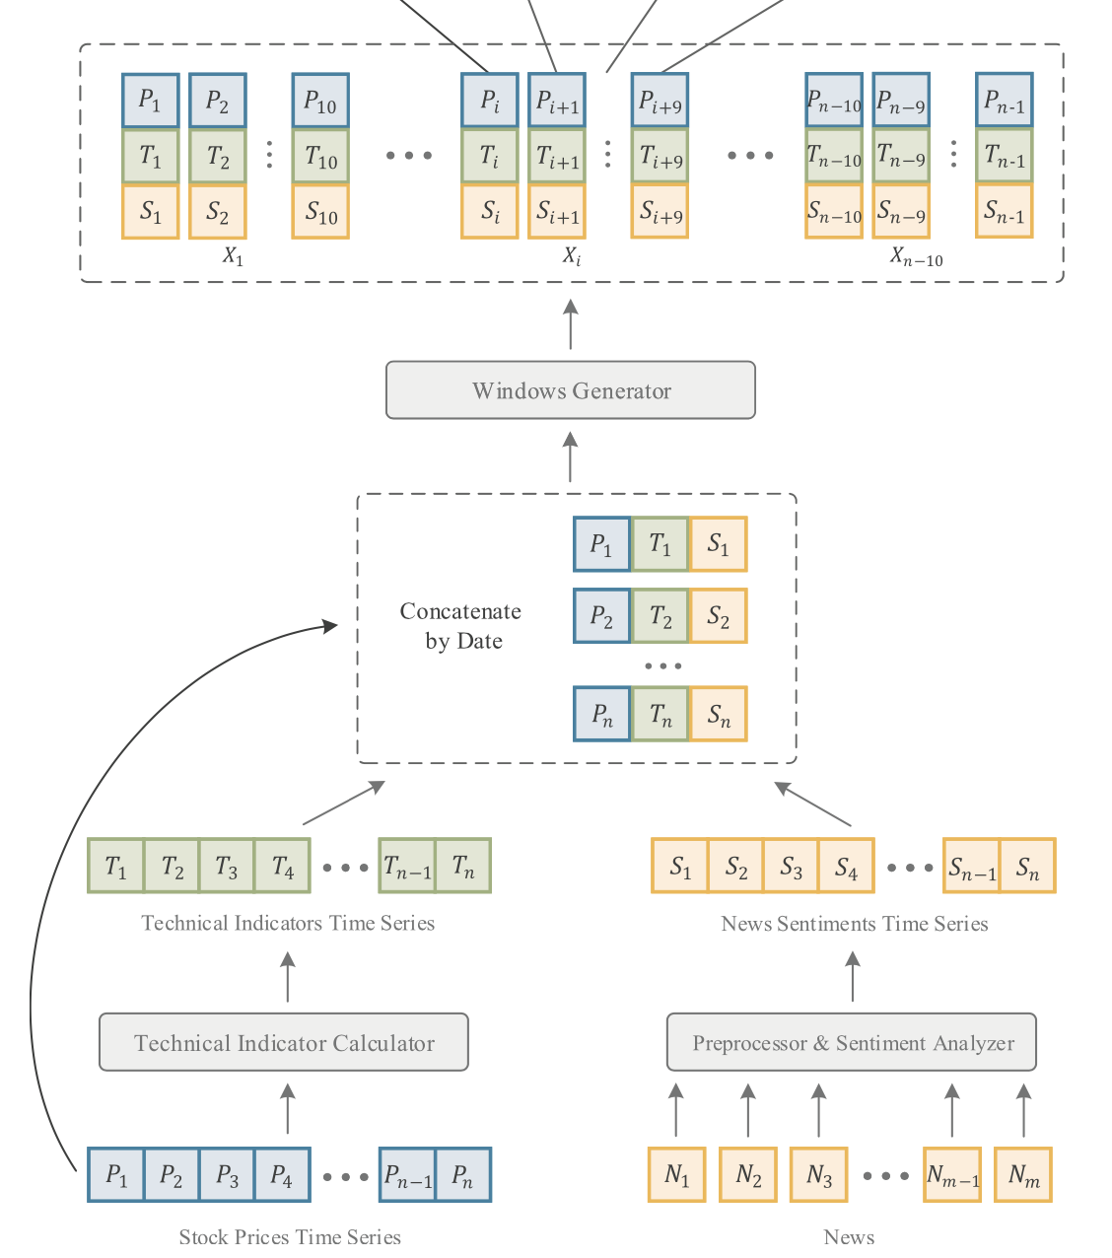
3 characteristic indexes
Original Data
We use six indicators(including lowest price, highest price, opening price, closing price, trading volume, shares outstanding) from transaction data file
Technical Indicators
We use 10 technical indicators ( including MA10, MA20, MA30, DIFF, DEA, MACD, RSI6, RSI12, RSI24, MFI )
These indicators can well reflect the historical changes of stocks
Sentimental Analyze
Calculated and averaged the polarities and subjectivities of all daily news as the emotional characteristics of stock news

Slide 7
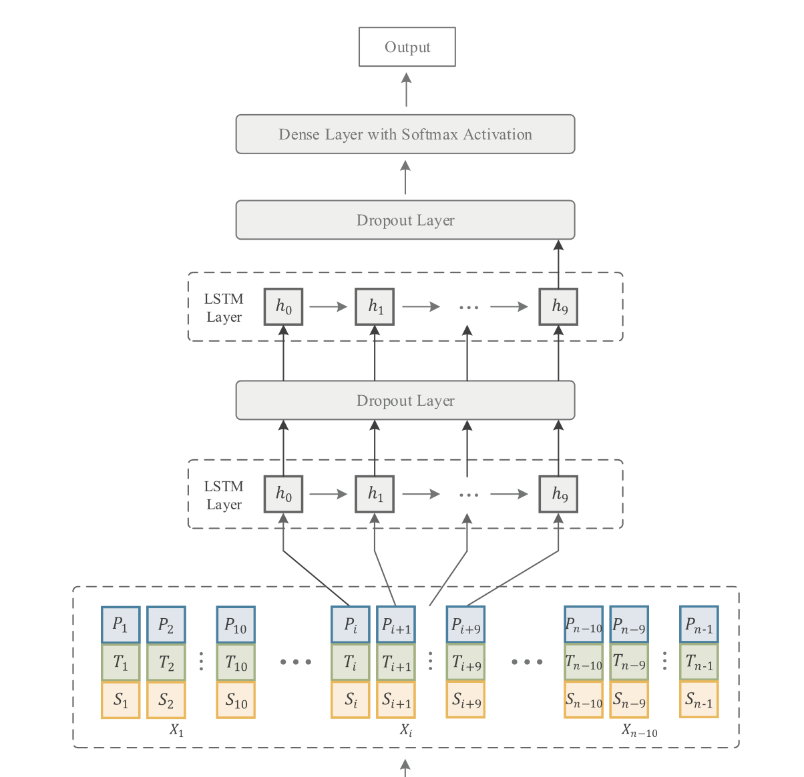
LSTM
1st layer : 200 units，using tanh as activation function ，return sequence to next layer
2nd layer : 100 units， using tanh as activation function , return sequence to next layer
3rd layer : 40 units, using tanh as activation function, return sequence to next layer
4th dense : 1 unit, using tanh as activation function, return sequence to next layer
loss function: mse optimizer: adam

Slide 8
Technical Indicators
Name | Meaning
MA10 | 10-day close price moving average
MA20 | 20-day close price moving average
MA30 | 30-day close price moving average
DIFF | The difference between EMA12 and EMA26
DEA | 9-day exponential moving average of DIFF
MACD | Moving average convergence and divergence
RSI6 | 6-day relative strength index
RSI12 | 12-day relative strength index
RSI24 | 24-day relative strength index
MFI | Money flow index

Slide 9
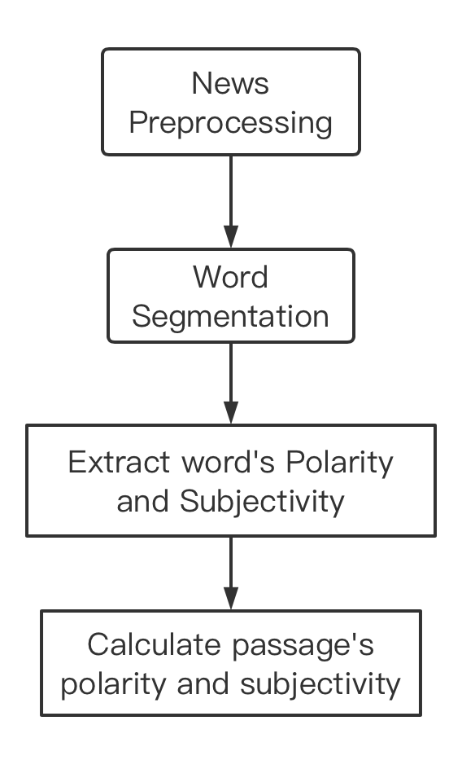
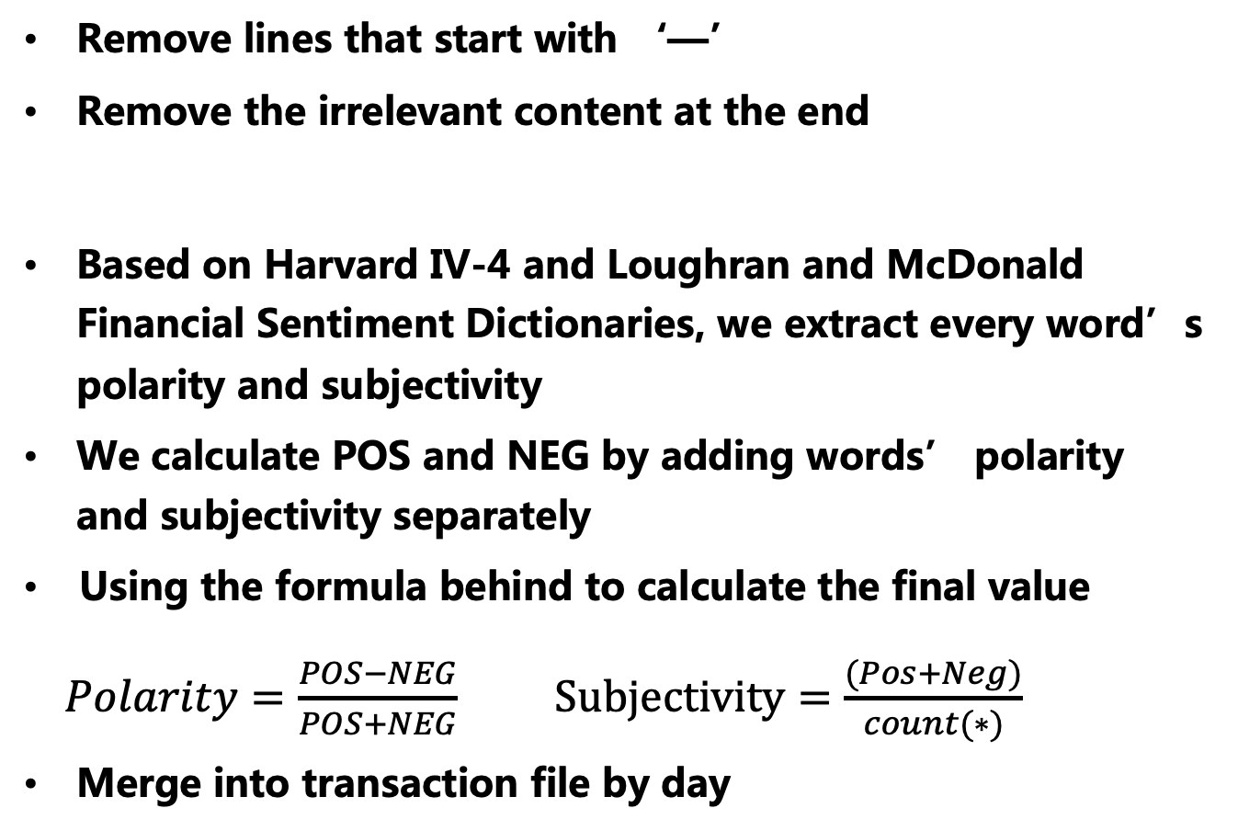
Sentiment Analyze
Remove lines that start with ‘—’
Remove the irrelevant content at the end
Based on Harvard IV-4 and Loughran and McDonald Financial Sentiment Dictionaries, we extract every word’s polarity and subjectivity
We calculate POS and NEG by adding words’ polarity and subjectivity separately
Using the formula behind to calculate the final value
$Polarity=\frac{POS−NEG}{POS+NEG}$ $Subjectivity=\frac{(Pos+Neg)}{count(∗)}$
Merge into transaction file by day

Slide 11
Explanation: Knowledge Distillation

Slide 12
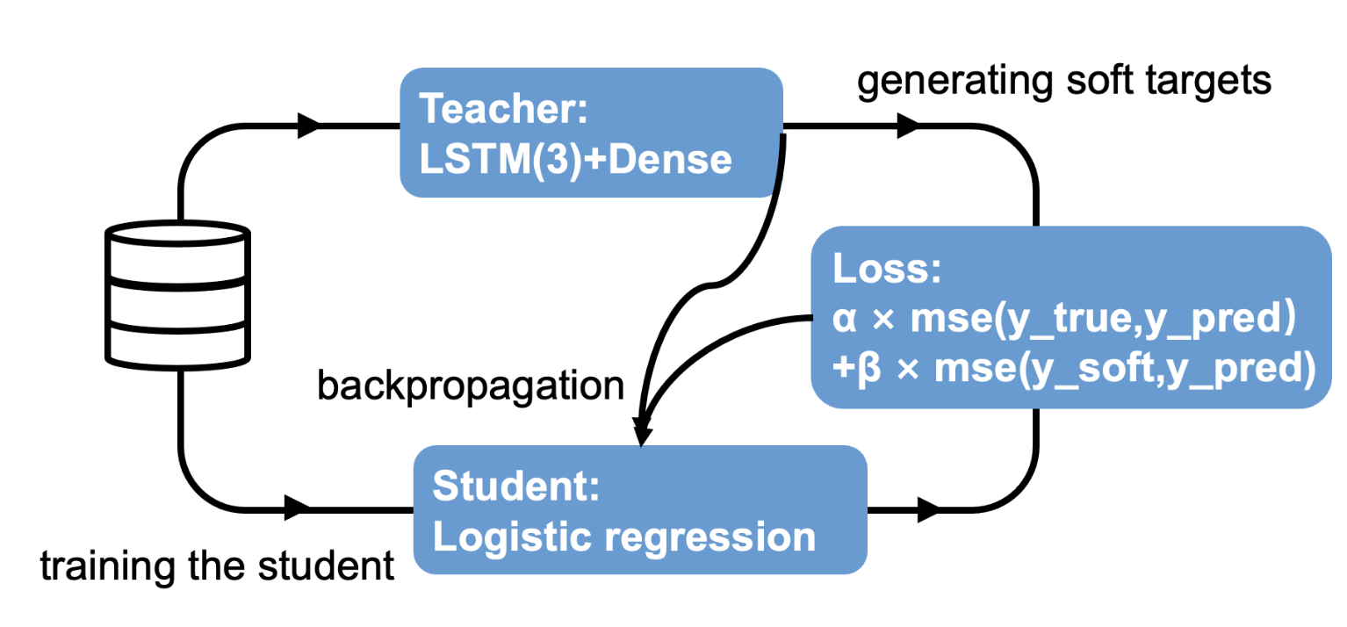
Knowledge Distillation
Choose one day’s value as X and next day‘s close price as y
The value of trained LSTM before activation was used as soft_ label（y_ soft）
Divide the data into training set and test set according to 7:3
Using a A single hidden layer neural network with 17 feature inputs and 1 feature output
Create a Logistic regression model
Set α as 0.75， β as 0.25
optimizer ：adam

Slide 14
Highlights
Design LSTM-Based PTS Model (combining historical data and daily news) to forecast the trend of stock price
Design Knowledge Distillation Model to calculate the weight of every characteristic index

Slide 15
DEMO

